Slide 1
What is DevOps?
Combination of standard practices, and tools that increases an organization’s ability to deliver applications and services at high velocity

Slide 2
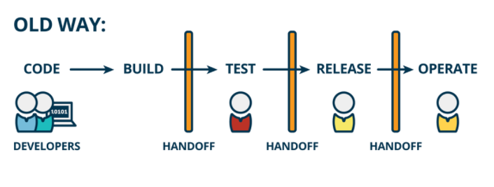
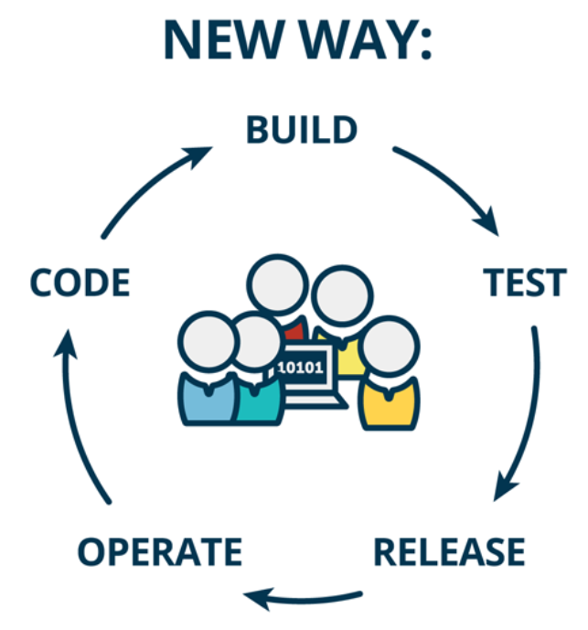
What is DevOps

Slide 3
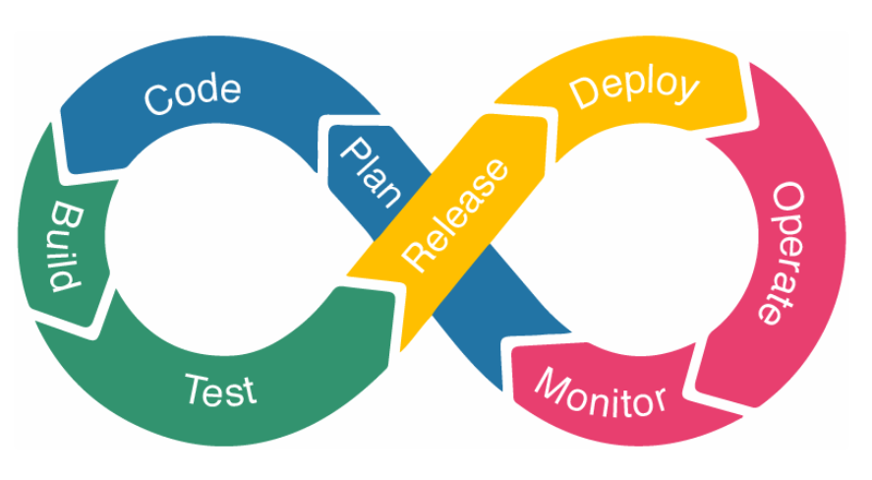
DevOps Lifecycle

Slide 4
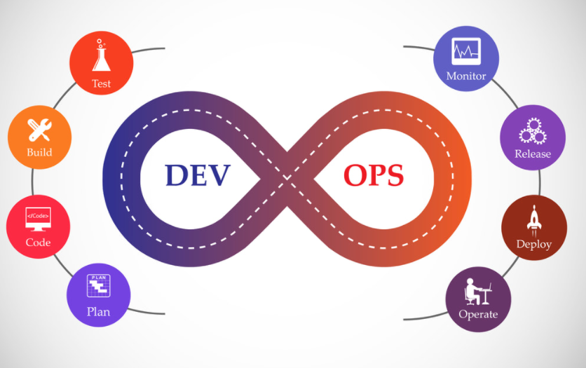
DevOps Phases

Slide 5
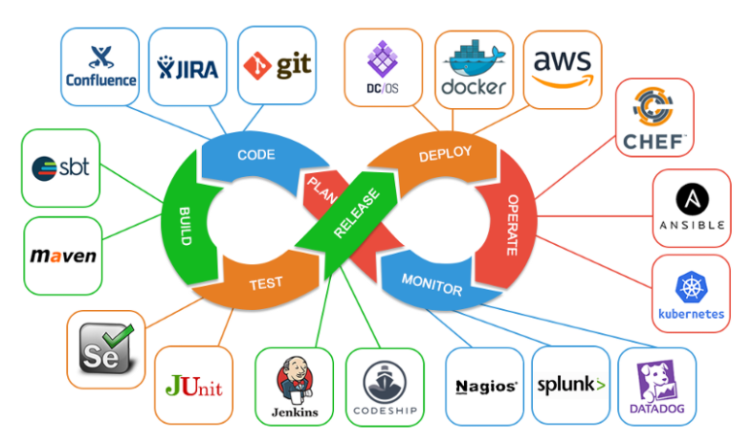
DevOps Tools

Slide 6
Continuous Integration
Continuous integration is a DevOps software development practice where developers regularly merge their code changes into a central repository, after which automated builds and tests are run
Continuous integration most often refers to the build or integration stage of the software release process
Every revision that is committed triggers an automated build and test
Goal is to find and address bugs quicker, improve software quality, and reduce the time it takes to validate and release new software updates

Slide 7
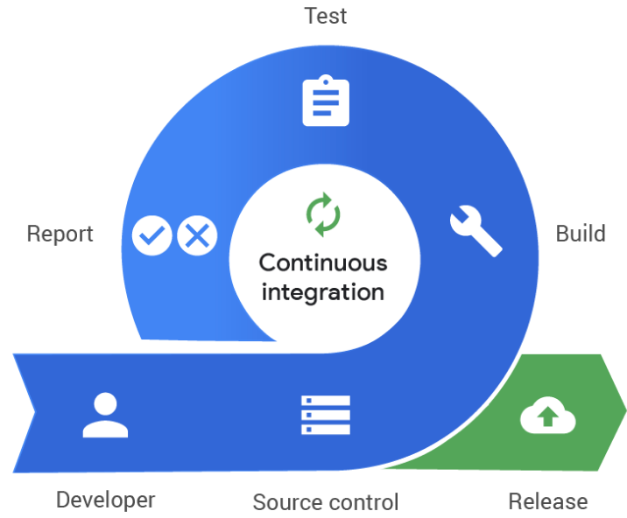
Continuous Integration

Slide 8

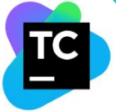




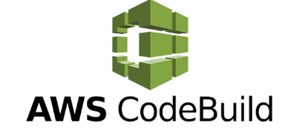
Continuous Integration Tools

Slide 9
Continuous Delivery
Every code change is built, tested, and then pushed to a non-production testing or staging environment
Automates the entire software release process
Every revision that is committed triggers an automated flow that builds, tests, and then stages the update.

Slide 10
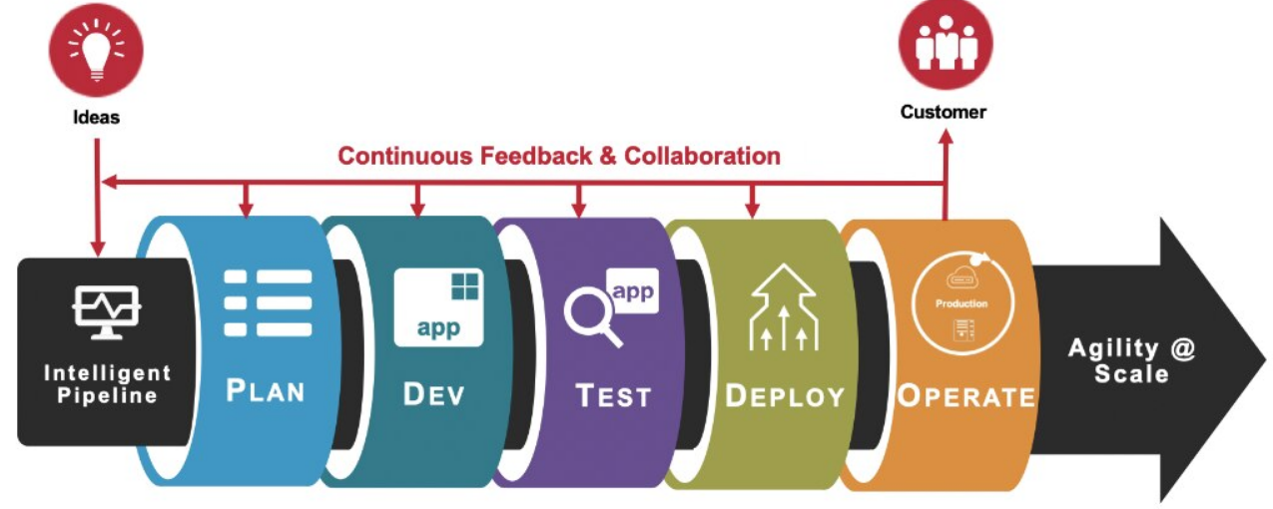
Continuous Delivery

Slide 11
Continuous Deployment
Software development method that releases or deploys software automatically into the production environment
The difference between continuous delivery and continuous deployment is the presence of a manual approval to update to production
Production happens automatically without explicit approval

Slide 12
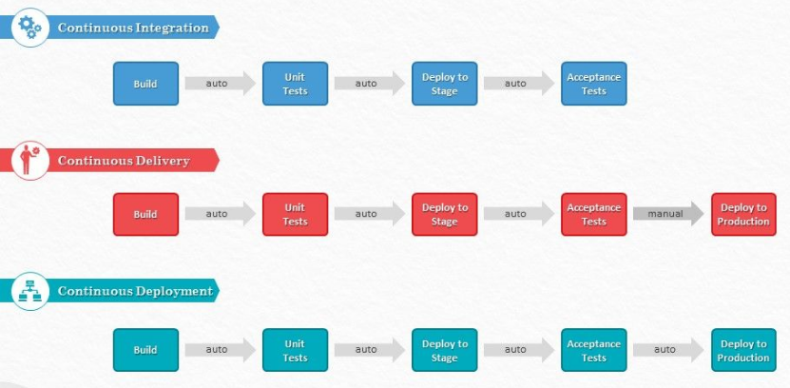
Continuous Integration Vs Continuous Deployment Vs Continuous Delivery

